Slide 1
Chapter 20
Care of Patients with Arthritis and Other Connective Tissue Diseases
Mrs. Kreisel MSN, RN
NU130 Adult Health
Summer 2011

Slide 2
Rheumatology
Connective tissue disease (CTD) is a major focus of rheumatology.
Rheumatic disease is any disease or condition involving the musculoskeletal system.
Arthritis means inflammation of one or more joints.

Slide 3
Rheumatology (Cont’d)
Noninflammatory arthritis (osteoarthritis) is not systemic. OA is not an autoimmune disease.
Inflammatory arthritis:
Rheumatoid arthritis
Systemic lupus erythematosus
Autoimmune disease
Connective tissue disease that is inflammatory

Slide 4
Osteoarthritis
Most common type of arthritis
Joint pain and loss of function characterized by progressive deterioration and loss of cartilage in the joints
Osteophytes
Synovitis
Subluxation

Slide 5
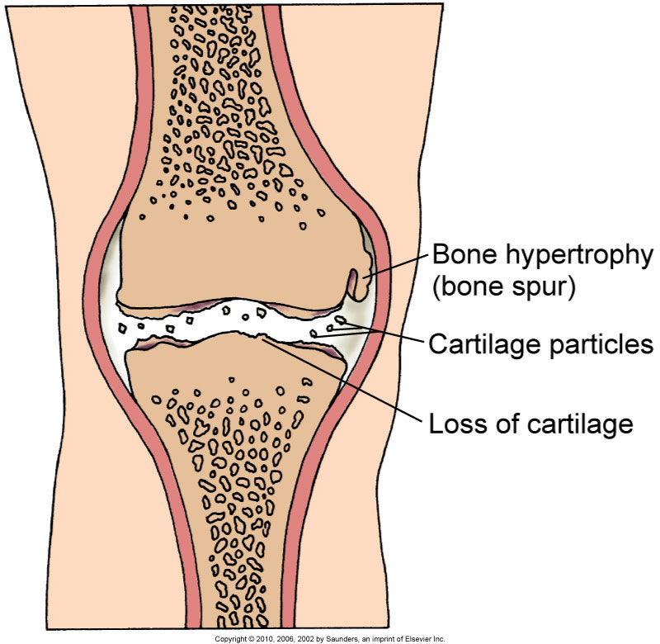
Joint Changes in Degenerative Joint Disease

Slide 6
Collaborative Management
History
Physical assessment and clinical manifestations:
Joint involvement
Heberden's nodes
Bouchard’s nodes
Joint effusions
Atrophy of skeletal muscle

Slide 7
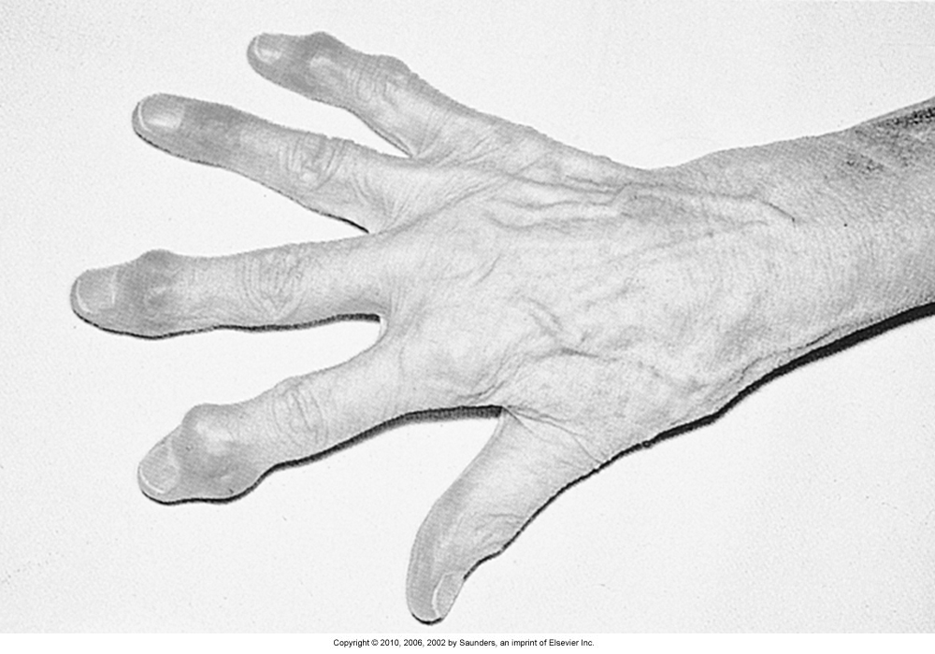
Heberden’s Nodes
Hard node or enlargements of the last phalanges of fingers. Most common in osteoarthritis.

Slide 8
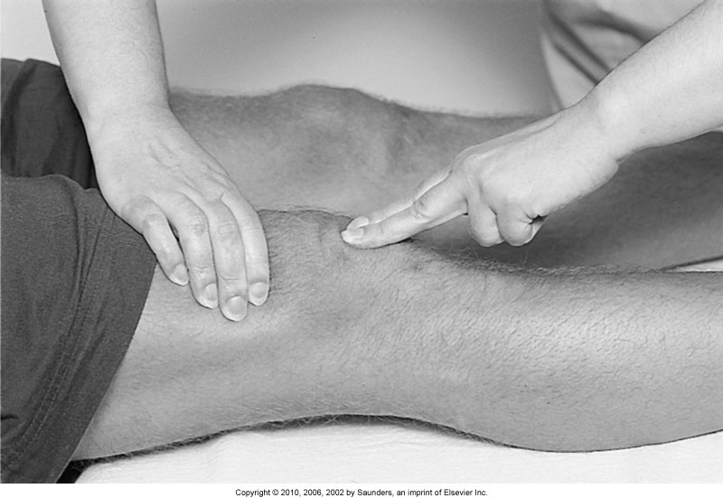
Ballottement
A palpatory technique used in detecting or examining a floating object in the body

Slide 9
Assessments
Psychosocial
Laboratory assessment of erythrocyte sedimentation rate and C-reactive protein (may be slightly elevated)
Radiographic assessment
Other diagnostic assessments:
MR imaging
CT studies

Slide 10
Chronic Pain: Nonsurgical Management
Analgesics
Rest
Positioning
Thermal modalities
Weight control
Integrative therapies

Slide 11
Chronic Pain: Surgical Management
Total joint arthroplasty (TJA)
Total joint replacement (TJR)
Arthroscopy
Osteotomy

Slide 12
Total Hip Arthroplasty
Preoperative care
Operative procedures
Postoperative care:
Prevention of dislocation, infection, and Deep vein thromboembolic complications
Assessment of bleeding
Management of anemia

Slide 13
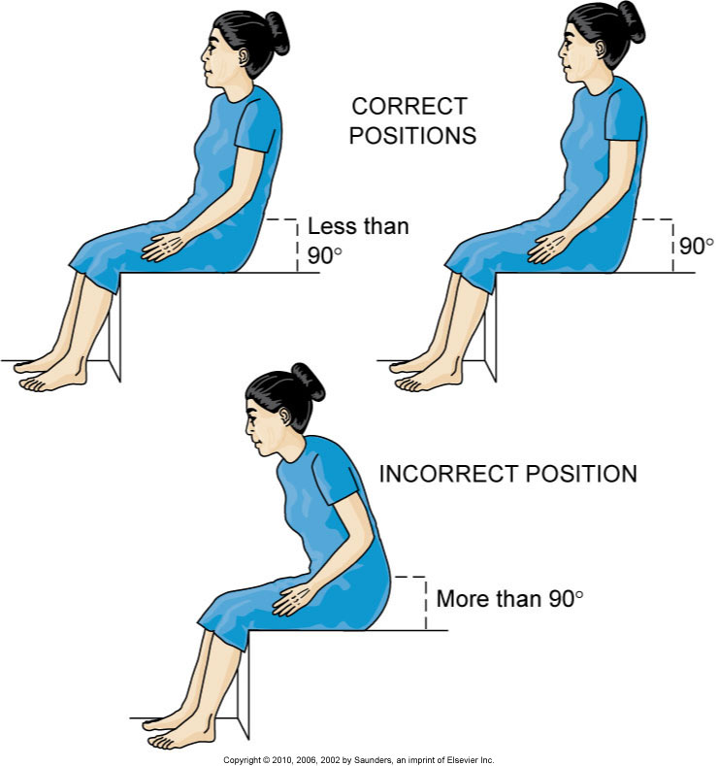
Hip Flexion After Total Hip Replacement

Slide 14
Prevention of Complications
Assessment for neurovascular compromise
Management of pain
Progression of activity
Promotion of self-care

Slide 15
Total Knee Arthroplasty
Preoperative care
Operative procedures
Postoperative care:
Continuous passive motion machine
Hot/ice device
Pain management
Neurovascular assessment

Slide 16
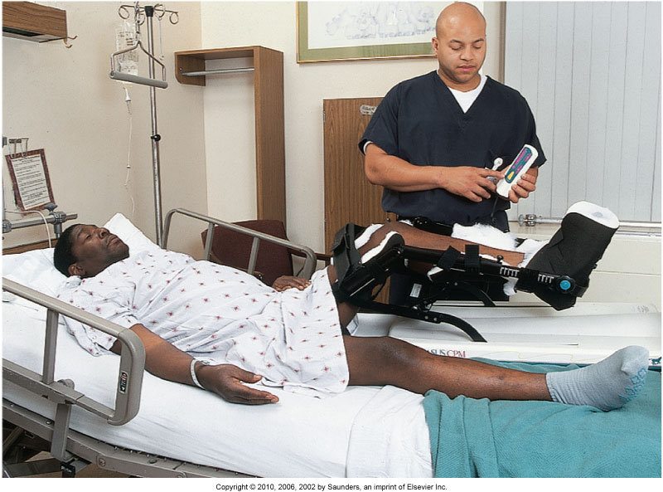
Continuous Passive Motion Machine

Slide 17
Other Joint Arthroplasties
Total shoulder arthroplasty
Total elbow arthroplasty
Phalangeal joint, metacarpal, or metatarsal arthroplasty

Slide 18
OA—Community-Based Care
Home care management
Health teaching
Health care resources

Slide 19
Rheumatoid Arthritis
One of the most common connective tissue diseases and the most destructive to the joints
Chronic, progressive, systemic inflammatory autoimmune disease affecting primarily the synovial joints
Autoantibodies (rheumatoid factors) formed that attack healthy tissue, especially synovium, causing inflammation
Affects synovial tissue of any organ or body system

Slide 20
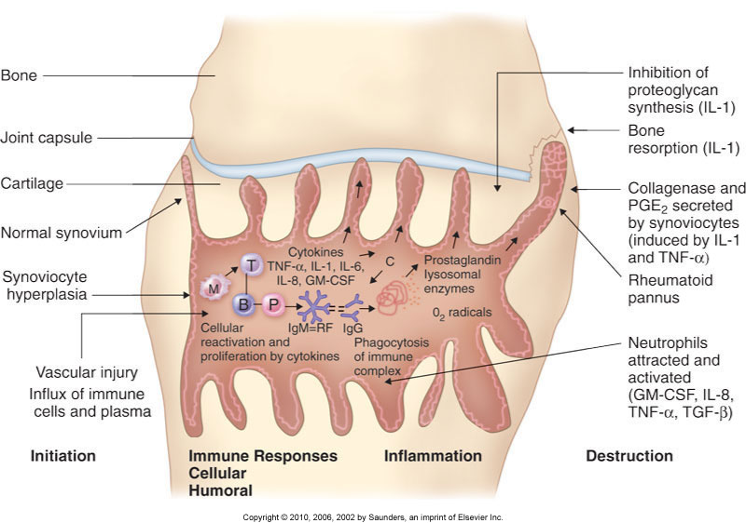
RA Pathology

Slide 21
RA—Collaborative Management
Assessment
Physical assessment and clinical manifestations:
Early disease manifestations—joint stiffness, swelling, pain, fatigue, and generalized weakness and morning stiffness
Late disease manifestations—as the disease worsens, the joints become progressively inflamed and quite painful

Slide 22
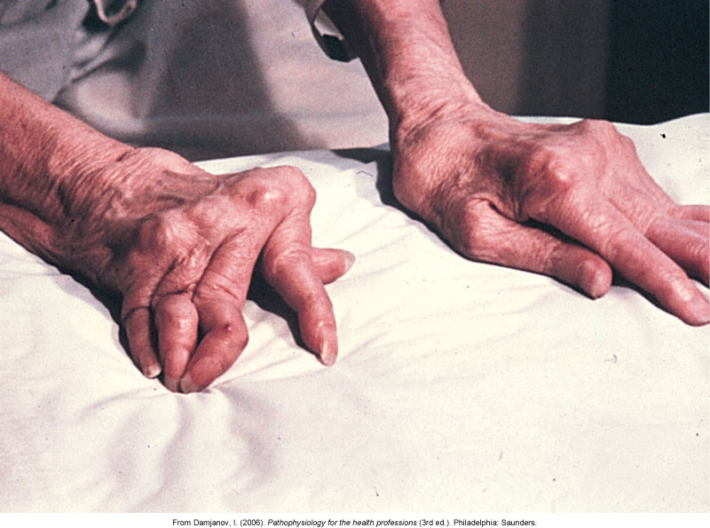
RA Joint Involvement

Slide 23
RA Systemic Complications
Weight loss, fever, and extreme fatigue
Exacerbations
Subcutaneous nodules
Pulmonary complications
Vasculitis (inflammation of the vascular system
Periungual (around the nail) lesions
Paresthesias (numbness & tingling)
Cardiac complications

Slide 24
RA—Associated Syndromes
Sjögren’s syndrome (post menopausal women, thought to be an immunological disorder)
Felty’s syndrome (Chronic RA associated with splenomegaly, neutropenia, and other blood disorders)
Caplan’s syndrome (RA with progressive fibrosis of the lung found in coal miners)

Slide 25
RA—Assessments
Psychosocial assessment
Laboratory assessment—rheumatoid factor, antinuclear antibody titer, erythrocyte sedimentation rate, serum complement, serum protein electrophoresis, serum immunoglobulins
Other diagnostic assessments—x-ray, CT, arthrocentesis, bone scan

Slide 26
RA—Drug Therapy
Disease-modifying antirheumatic drugs
NSAIDs
Biologic response modifiers
Other drugs:
Glucocorticoids
Immunosuppressive agents
Gold therapy
Analgesic drugs

Slide 27
RA—Nonpharmacologic Interventions
Adequate rest
Proper positioning
Ice and heat applications
Plasmapheresis
Gene therapy
Complementary and alternative therapies
Promotion of self-care

Slide 28
RA—Nonpharmacologic Interventions (Cont’d)
Management of fatigue
Enhancement of body image
Community-based care:
Home care management
Health teaching
Health care resources

Slide 29
Lupus Erythematosus
Chronic, progressive, inflammatory connective tissue disorder that can cause major body organs and systems to fail.
Characterized by spontaneous remissions and exacerbations.
Autoimmune process.
Autoimmune complexes tend to be attracted to the glomeruli of the kidneys.
Many patients with SLE have some degree of kidney involvement.

Slide 30
Lupus Erythematosus—Clinical Manifestations
Skin involvement
Polyarthritis
Osteonecrosis
Muscle atrophy
Fever and fatigue

Slide 31
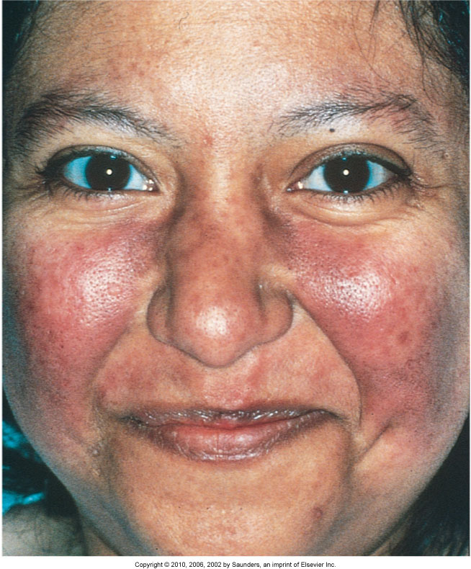
Characteristic “Butterfly” Rash of Systemic Lupus Erythematosus

Slide 32
LE—Clinical Manifestations
Renal involvement
Pleural effusions
Pericarditis
Neurologic manifestation

Slide 33
Assessments for Lupus
Psychosocial results can be devastating.
Laboratory:
Skin biopsy (only significant test to confirm diagnosis)
Immunologic-based laboratory tests
Complete blood count
Body system function assessment

Slide 34
SLE—Drug Therapy
Topical drugs
Plaquenil
Tylenol or NSAIDs
Chronic steroid therapy
Immunosuppressive agents

Slide 35
Scleroderma (Systemic Sclerosis)
Chronic, inflammatory, autoimmune connective tissue disease
Not always progressive
Hardening of the skin

Slide 36
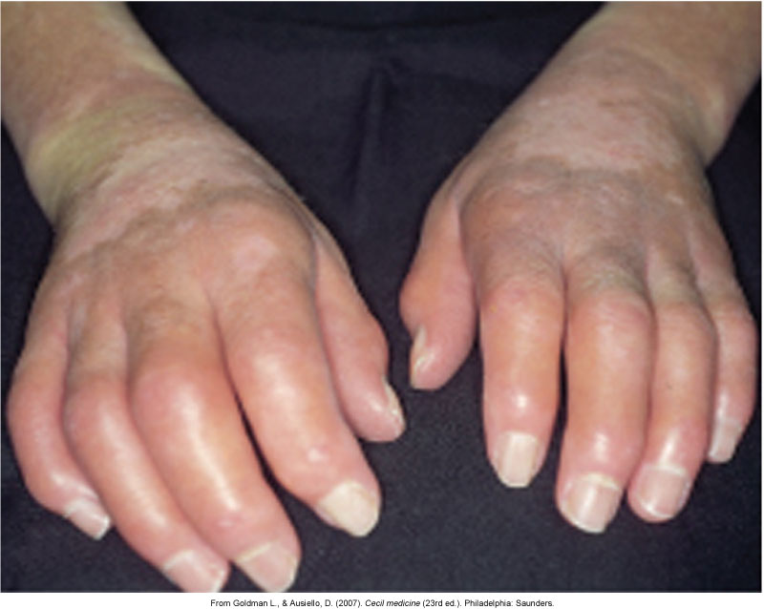
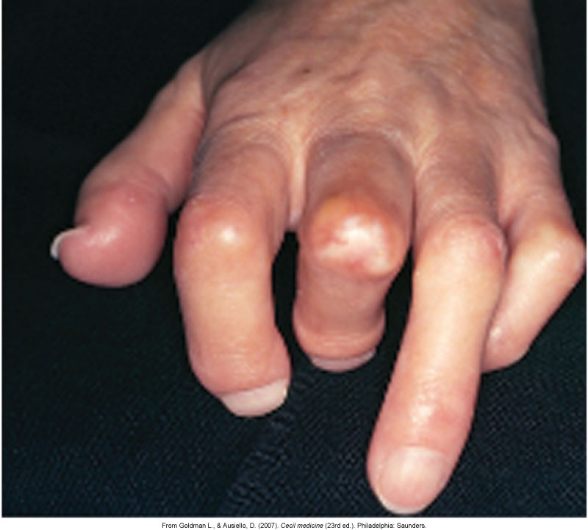
Scleroderma

Slide 37
Scleroderma—Clinical Manifestations
Arthralgia
GI tract
Cardiovascular system
Pulmonary system
Renal system

Slide 38
Scleroderma—Interventions
Drug therapy
Identify early organ involvement
Skin protective measures
Comfort
GI manifestation
Mobility

Slide 39
Gout
Also called gouty arthritis, a systemic disease in which urate crystals deposit in the joints and other body tissues, causing inflammation
Primary gout
Secondary gout—hyperuricemia

Slide 40
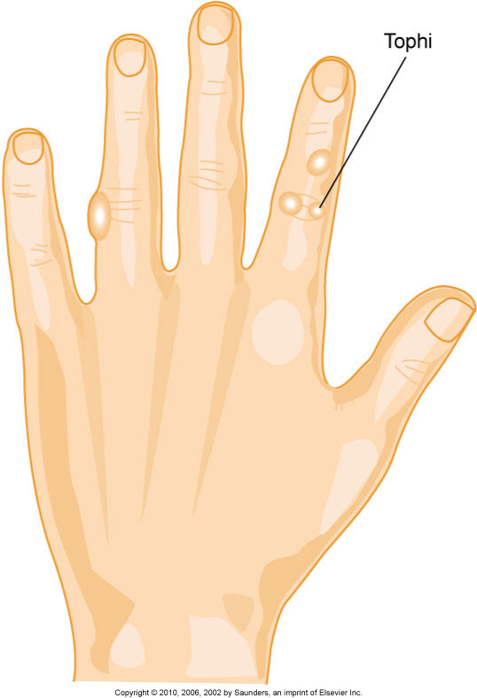
Gout—Interventions
Drug therapy: Allopurinol-blocks uric acid production.
Nutritional therapy

Slide 41
Lyme Disease
Reportable systemic infectious disease caused by the spirochete Borrelia burgdorferi, resulting from the bite of an infected deer tick.
Stages I and II.
If not diagnosed and treated in early stages, chronic complications such as arthralgias, fatigue, and memory and thinking problems can result.
For some patients, the first and only sign of Lyme disease is arthritis.

Slide 42
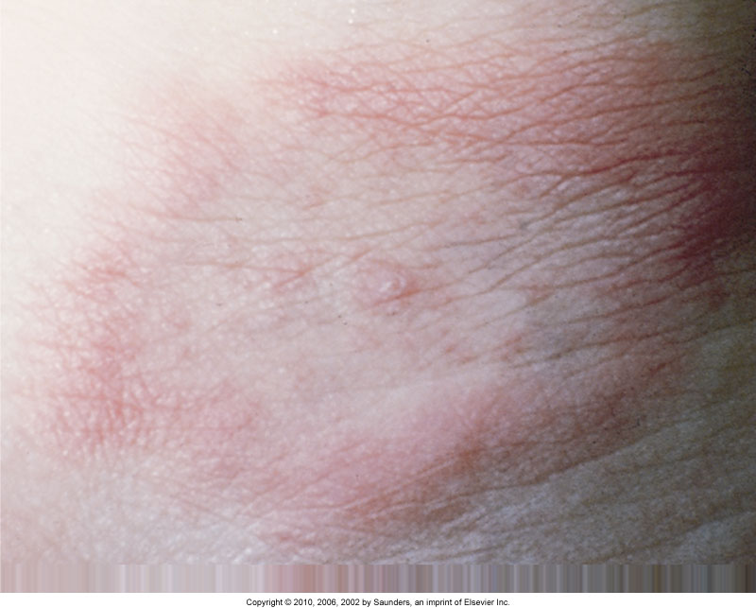
Lyme Disease Rash

Slide 43
Fibromyalgia Syndrome
Chronic pain syndrome, not an inflammatory disease

Slide 44
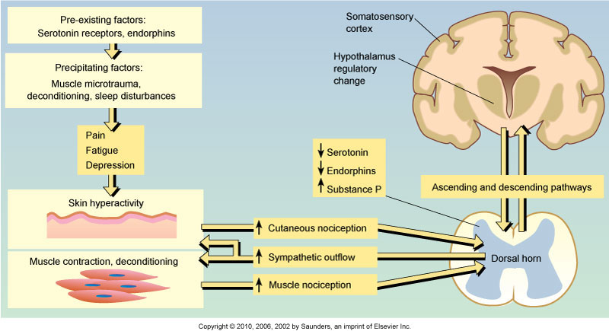
Theoretic Pathophysiologic Model of Fibromyalgia

Slide 45
Chronic Fatigue Syndromes
Chronic illness in which patients have severe fatigue for 6 months or longer, usually following flu-like symptoms
Sore throat; substantial impairment in short-term memory or concentration; tender lymph nodes; muscle pain; multiple joint pain with redness or swelling; headaches of a new type, pattern, or severity; unrefreshing sleep; and postexertional malaise lasting more than 24 hours

Slide 46
NCLEX TIME

Slide 47
Question 1
Most patients diagnosed with fibromyalgia syndrome
are:
Men between 30 and 50 years of age
Men between 50 and 70 years of age
Women between 30 and 50 years of age
Women between 50 and 70 years of age
Notes:
Answer: C
Rationale: Most patients diagnosed with fibromyalgia syndrome are women between 30 and 50 years of age.

Slide 48
Question 2
The patient is complaining of abdominal pain, a low-
grade fever, and persistent fatigue. Which of these does
the nurse suspect he may have?
Systemic sclerosis
Lupus erythematosus
Ankylosing spondylitis
Polymyalgia rheumatica
Notes:
Answer: B
Rationale: Abdominal pain, low-grade fever, and persistent fatigue are symptoms characteristic of lupus erythematosus. Systemic sclerosis is characterized by esophagitis and ulcers rather than abdominal pain. Ankylosing spondylitis is characterized by iritis and joint pain. Polymyalgia rheumatica is characterized by aching of the shoulder and pelvic girdles.

Slide 49
Question 3
A patient has been receiving treatment once a week
with low doses of methotrexate. Which condition does
the patient have?
Rheumatoid arthritis (RA)
Fibromyalgia syndrome
Systemic lupus erythematosus
Breast cancer
Notes:
Answer: A
Rationale: Methotrexate (Rheumatrex), an immunosuppressive medication, in a low, once-a-week dosage (generally 25 mg or less per week), has become the mainstay of therapy for RA.

Slide 50
Question 4
Hydroxychloroquine (Plaquenil) is often used to treat
rheumatoid arthritis (RA) or systemic lupus
erythematosus (SLE), but it is usually prescribed for
which condition?
Depression
Chronic pain
Malaria
Lyme disease
Notes:
Answer: C
Rationale: Hydroxychloroquine (Plaquenil) is an antimalarial drug that helps decrease joint and muscle pain and often helps patients with early RA or other inflammatory autoimmune diseases such as SLE.

Slide 51
Question 5
During therapy with Arava for rheumatoid arthritis, a
major concern is:
Risk for renal damage
Potential birth defects if pregnancy occurs during therapy
Fatigue caused by anemia
Changes in the cornea or lens
Notes:
Answer: B
Rationale: Arava can cause birth defects, and therefore strict birth control to women of childbearing age is necessary during therapy. Patients should be told to contact the health care provider immediately if pregnancy occurs while taking the drug.

