Slide 1
Chapter 67
Care of Patients with Diabetes Mellitus
Marion Kreisel MSN, RN
Adult Health 2 NU230
Fall 2011

Slide 2
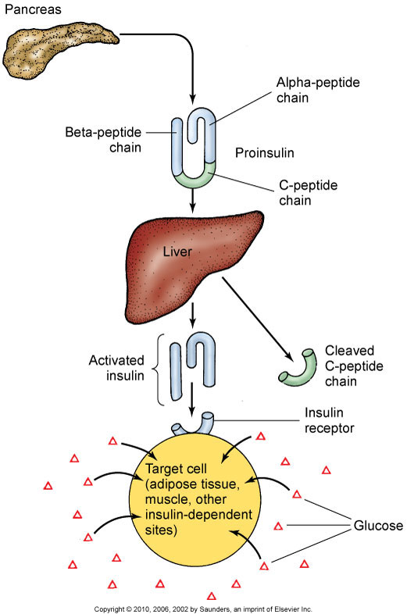
Insulin Physiology
http://www.youtube.com/watch?v=hwE1osnb5qc
http://www.youtube.com/watch?v=_w7u6ZzlaFc&feature=related

Slide 3
Types of Diabetes
Type I
Type 2
Gestational Diabetes (GDM)
Other specific conditions resulting in hyperglycemia

Slide 4
Absence of Insulin
Hyperglycemia
Polyuria
Polydipsia
Polyphagia
Ketone bodies
Hemoconcentration, hypovolemia, hyperviscosity, hypoperfusion, and hypoxia
Acidosis, Kussmaul respiration
Hypokalemia, hyperkalemia, or normal serum potassium levels

Slide 5
Acute Complications of Diabetes
Diabetic ketoacidosis
Hyperglycemic-hyperosmolar state (HHS)
Hypoglycemia from too much insulin or too little glucose

Slide 6
Chronic Complications of Diabetes
Macrovascular and microvascular disease
Retinopathy (vision problems)
Nephropathy (kidney dysfunction)
Neuropathy (nerve dysfunction)

Slide 7
Macrovascular Complications
Cardiovascular disease
Cerebrovascular disease
Microvascular Complications
Eye and vision complications
Diabetic neuropathy
Diabetic nephropathy
Male erectile dysfunction
To delay the onset of these illnesses, CONTROL HYPERGLYCEMIA

Slide 8
Health Promotion and Maintenance
Control of diabetes and its complications is a major focus for health promotion activities.
Patients get anxious when d/c from hospital and may forget what to do when they are not feeling well. They may call the hospital and ask what to do. Know the signs and symptoms of Hypo vs hyper glycemia and whether or not to tell the patient to take their insulin or not

Slide 9
Assessment
History: Screening people look at family history for ANY TYPE of Diabetes. People have a greater susceptibility for developing the disease if in family.
Blood tests:
Fasting plasma glucose (FPG)
Oral glucose tolerance test (OGTT)
Other blood tests for diabetes
Screening for diabetes
Ongoing assessment—glycosylated hemoglobin assays of 9%, gluycosylated serum proteins and albumin, urine tests, tests for renal function

Slide 10
Drug Therapy
Oral therapy:
Sulfonylurea agents: AVOID NSAIDS
Meglitinide analogues
Biguanides
Alpha-glucosidase inhibitors
Thiazolidinediones
Combination agents

Slide 11
Insulin Therapy
Types of insulin
Insulin regimens
Factors influencing insulin absorption
Mixing insulins

Slide 12
Complications of Insulin Therapy
Lipoatrophy: is the term describing the localized loss of fat tissue. This may occur as a result of subcutanous injections of insulin in the treatment of diabetes.
Lipohypertrophy: is a medical term that refers to a lump under the skin caused by accumulation of extra fat at the site of many subcutaneous injections of insulin. It may be unsightly, mildly painful, and may change the timing or completeness of insulin action. It is a common, minor, chronic complication of diabetes mellitus.
To avoid lipohypertrophy, persons with diabetes mellitus who inject insulin daily for an extended period of time are advised to rotate their injections among several areas (usually upper, outer arms, outer thighs, abdomen below and around the umbilicus, and the upper parts of the buttocks.

Slide 13
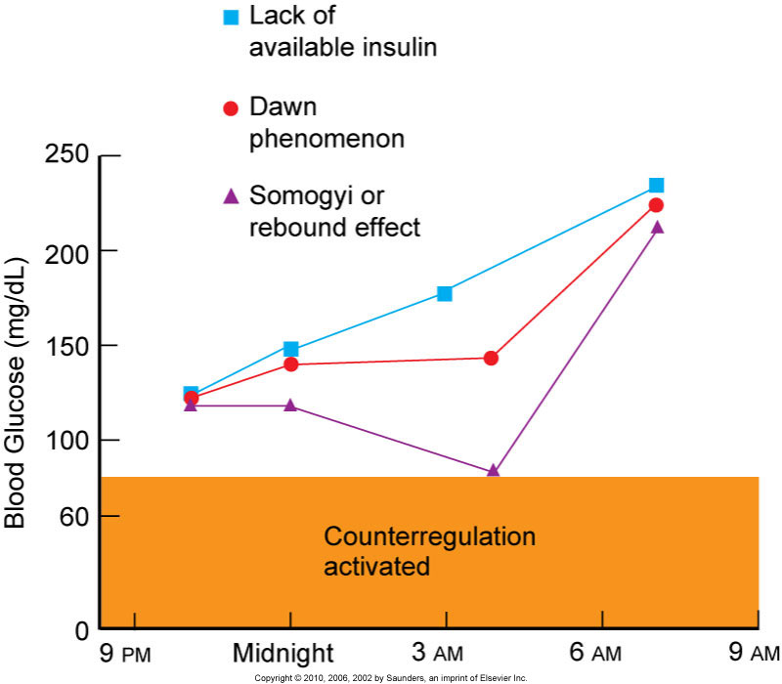
Complications of Insulin Therapy
Dawn phenomenon:
Somogyi’s phenomenon:The Somogyi effect is most likely to occur following an episode of untreated nighttime hypoglycemia, resulting in high blood sugar levels in the morning. People who wake up with high blood sugar may need to test their blood glucose levels in the middle of the night (for example, around 3 AM).
http://www.youtube.com/watch?v=L8KmpTvAZ3U
Notes:
The tendency of the body to react to extremely low blood sugar (hypoglycemia) by overcompensating, resulting in high blood sugar. The Somogyi effect, also known as the “rebound” effect, was named after Michael Somogyi, the researcher who first described it.
When blood glucose levels drop too low, the body sometimes reacts by releasing counterregulatory hormones such as glucagon and epinephrine. These hormones spur the liver to convert its stores of glycogen into glucose, raising blood glucose levels. This can cause a period of high blood sugar following an episode of hypoglycemia.
The Somogyi effect is most likely to occur following an episode of untreated nighttime hypoglycemia, resulting in high blood sugar levels in the morning. People who wake up with high blood sugar may need to test their blood glucose levels in the middle of the night (for example, around 3 AM). If their blood sugar level is falling or low at that time, they should speak with their health-care team about increasing their food intake or lowering their insulin dose in the evening. The only way to prevent the Somogyi effect is to avoid developing hypoglycemia in the first place.

Slide 14
Alternative Methods of Insulin Administration
Continuous subcutaneous infusion
Injection devices
New technology

Slide 15
Patient Education
Types of Insulin
Oral can only be used if the pancreases can still produce some insulin
Injectable: Short acting,Mid acting,Long term
Mixed insulin give s a blous to prevent hyperglycemia after breakfast and last for most day 70/30 (70 long acting 30 short acting)
Insulin storage
Dose preparation: Draw up short acting clear insulin first before cloudy long acting insulin
Syringes
Blood glucose monitoring
Infection control measures: especially after any surgery
Diet therapy

Slide 16
Principles of Nutrition in Diabetes
Protein
Dietary fat and cholesterol
Fiber
Sweeteners
Alcohol

Slide 17
Meal Planning Strategies
Exchange systems
Carbohydrate counting

Slide 18
Hyperinsulinemia
Chronic high blood insulin levels that can occur with intensive treatment schedules and may result in weight gain.
These patients may need to treat hyperglycemia by restricting calories rather than by increasing insulin.
Weight gain can be minimized by following the prescribed meal plan, getting regular exercise, and avoiding overtreatment of hypoglycemia.

Slide 19
Exercise Therapy
Regular exercise is an essential part of a diabetic treatment plan
Benefits of exercise
Exercise in the presence of long-term complications of diabetes
Assessment before initiating an exercise program
Guidelines for exercise
Hydrate adequately & always carry a carbohydrate snack

Slide 20
Surgical Management
Transplantation of the pancreas
Whole-pancreas transplantation
Islet cell transplantation

Slide 21
Proper Foot Care
Foot injury is the most common complication of diabetes leading to hospitalization
Prevention of high-risk conditions
Peripheral sensation management
Footwear
Foot care

Slide 22
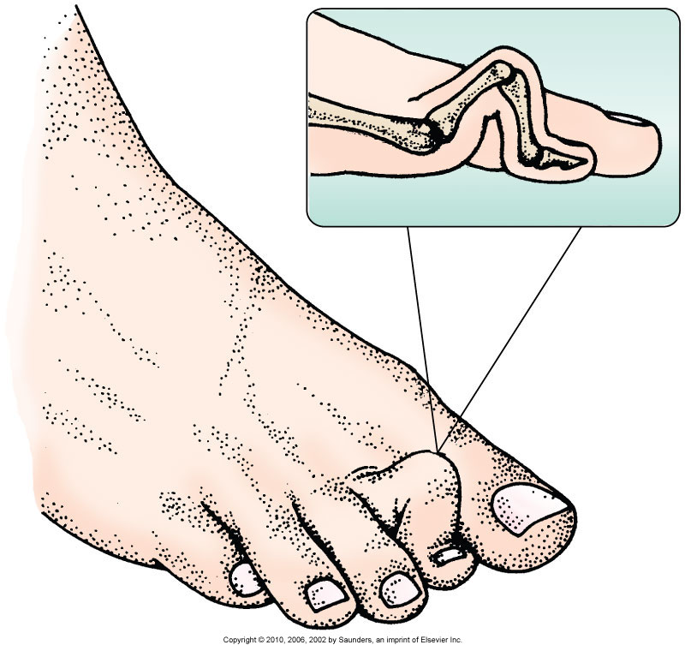
Hammertoe

Slide 23
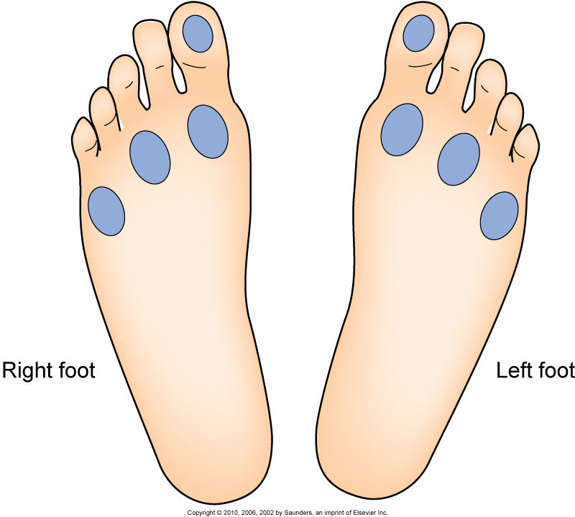
Testing Sensation
Examine feet for injury when pt has decreased sensation

Slide 24
Wound Care
Wound environment
Débridement
Elimination of pressure
Growth factors

Slide 25
Chronic Pain
Neuropathic pain results from damage to the nervous system anywhere along the nerve
Pharmacologic agents
Nonpharmacologic interventions

Slide 26
Risk for Injury Related to Disturbed Sensory Perception: Visual
Interventions include:
Blood glucose control
Increase for cataracts, glaucoma, & retinal blood vessel changes. See ophthalmologist yearly no matter what
Environmental management:
Incandescent lamp
Coding objects
Syringes with magnifiers
Use of adaptive devices

Slide 27
Ineffective Tissue Perfusion: Renal
Interventions include:
Control of blood glucose levels
Yearly evaluation of kidney function
Control of blood pressure levels
Prompt treatment of UTIs
Avoidance of nephrotoxic drugs
Diet therapy
Fluid and electrolyte management
Monitor Urine for Protein

Slide 28
Potential for Hypoglycemia
Blood glucose level <70 mg/dL
Confused, hard to arouse, sluggish
Diet therapy—carbohydrate replacement
Drug therapy—glucagon, 50% dextrose, diazoxide, octreotide
Prevention strategies for:
Insulin excess
Deficient food intake
Exercise: Be hydrated and carry a carbohydrate snack
Alcohol

Slide 29
Diabetic Ketoacidosis
Diabetic ketoacidosis is a serious complication of diabetes that occurs when your body produces very high levels of blood acids called ketones. Diabetic ketoacidosis develops when you have too little insulin in your body. Without enough insulin, your body begins to breaks down fat as an alternate fuel. In turn, this process produces toxic acids in the bloodstream called ketones, eventually leading to diabetic ketoacidosis. Vomiting, dehydration, deep gasping breathing, confusion and occasionally coma are typical symptoms. DKA is diagnosed with blood and urine tests; it is distinguished from other, rarer forms of ketoacidosis by the presence of high blood sugar levels. Treatment involves isotonic saline intravenous fluids (A solution that has the same salt concentration as the normal cells of the body and the blood.) to correct dehydration, insulin to suppress the production of ketone bodies
DKA is a medical emergency, and without treatment it can lead to death.

Slide 30
Potential for Diabetic Ketoacidosis
Interventions include:
Monitoring for manifestations
Assessment of airway, level of consciousness, hydration status, blood glucose level
Kussmaul’s respirations: Deep, rapid respiration characteristic of diabetic acidosis TX: ISOTONIC SALINE
Hyperglycemia management
Management of fluid and electrolytes
Drug therapy goal—to lower serum glucose slowly
Management of acidosis
Patient education—prevention: whenever ill or blood sugar >300mg/dL check urine ketones
http://www.youtube.com/watch?NR=1&v=hDMaolXm_yI

Slide 31
Potential for Hyperglycemic-Hyperosmolar Nonketotic Syndrome (HHNS)
Hyperosmolar state caused by hyperglycemia
Differences of DKA (Fast insulin administration) and HHNS (slow insulin administration)
Monitoring
Fluid therapy
Continuing therapy
What are the warning signs?
Blood sugar level over 600 mg/dl
Dry, parched mouth
Extreme thirst (although this may gradually disappear)
Warm, dry skin that does not sweat
High fever (over 101 degrees Fahrenheit, for example)
Sleepiness or confusion
Loss of vision
Hallucinations (seeing or hearing things that are not there)
Weakness on one side of the body

Slide 32
Community-Based Care
Home care management
Health teaching: When they are ready teach them how to make good choices about their diabetes
Health care resources

Slide 33
Chapter 67
NCLEX TIME
Care of Patients with Diabetes Mellitus

Slide 34
Question 1
The patient with diabetes is at high risk for death from:
Cerebrovascular accident
Diabetic nephropathy
Myocardial infarction
Diabetic ketoacidosis
Notes:
Answer: C
Rationale: Myocardial infarction is known to be the leading cause of death among patients with diabetes.

Slide 35
Question 2
Which symptom requires immediate intervention during a hypoglycemic episode?
Confusion
Anxiousness
Hunger
Tachycardia
Notes:
Answer: A
Rationale: Glucose is necessary for brain function. Thus confusion is a marker of severe hypoglycemia requiring immediate intervention.

Slide 36
Question 3
Which patient with diabetes mellitus is at greatest risk for developing retinopathy?
28-year-old with gestational diabetes
36-year-old with type 1 diabetes and hypertension
62-year-old with fasting blood glucose level of 120 mg/dL
54-year-old with type 2 diabetes mellitus and hypertension
Notes:
Answer: B
Rationale: Hyperglycemia (fasting blood glucose levels above 129 mg/dL) and hypertension increase the rate of retinopathy development in patients with type 1 diabetes. Retinopathy is a potential complication for all patients with diabetes mellitus.

Slide 37
Question 4
Which ethnic/racial group is most likely to have a higher rate of diabetes mellitus in the United States?
Non-Hispanic Whites
Non-Hispanic Blacks
Hispanic-Latino Americans
American Indians and Alaskan Natives
Notes:
Answer: D
Rationale: American Indians and Alaskan Natives have the highest prevalence (99,500, or 12.8%) of diabetes in people older than 20 years in the United States.
Source: www.diabetes.org/diabetes-statistics/prevalence.jsp

Slide 38
Question 5
When should a type 1 diabetic patient avoid exercise?
When serum glucose is less than 150
During colder months
When ketones are present in the urine
When emotional stressors are high for the patient
Notes:
Answer: C
Rationale: Exercise should be avoided if ketones are present in the urine. Ketones indicate that current insulin levels are not adequate and that exercise would elevate blood glucose levels.
Source: www.diabetes.org/weightloss-and-exercise/exercise/getting-started.jsp

Slide 39
http://www.youtube.com/watch?v=qRGQiTbWMxk&feature=related
http://www.youtube.com/watch?v=OsxaF48HnuI&feature=related

